Slide 1
Threading and Parallel Processing

Slide 2
Notes for break
Listed as an assignment on canvas:
If you need me to do anything:
Grade assignment
Note that midterm wasn’t submitted on canvas, but on git
Etc
Submit to this assignment
It is essentially my to-do list for spring break
Moving forward, mac users will need to do something special.

Slide 3
Amazing resource
http://www.albahari.com/threading/

Slide 4
Moore’s Law
“The number of transistors and resistors on a chip doubles every 24 months”
–Gordon Moore, 1965
“I see Moore’s law dying here in the next decade or so”
–Gordon Moore, 2015
https://www.youtube.com/watch?v=rtI5wRyHpTg

Slide 5
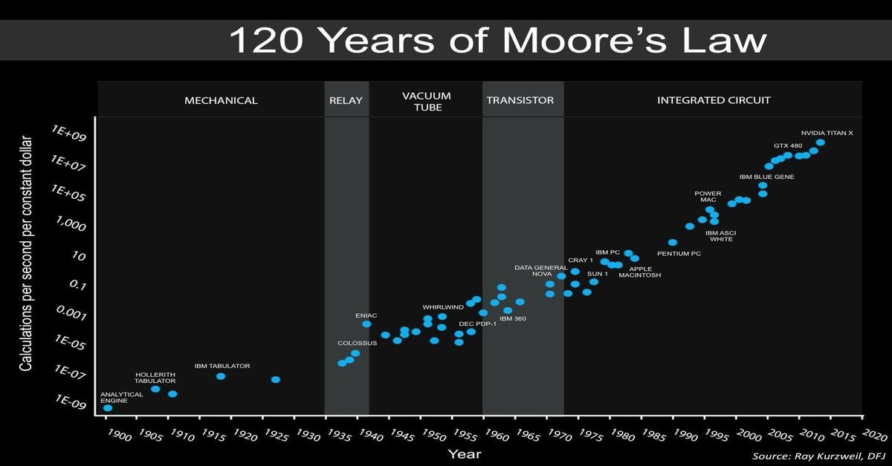

Slide 6
Many solutions
Switching from Von Neumann architecture to something else like a neuromorphic architecture.
Works more like our brains than a computer.
Quantum computing
Useful for some problems, not all.
More optimized code
Regardless of the solution, it is hard to implement

Slide 7
Optimizing code from an engineers perspective
Due to the quantum issues we are facing, improving the performance of software comes down to the engineers writing the code. –Dr. Al Glock

Slide 8
Background keywords
Clock Speed – Cycles per second in Hz (hertz)
Word size – number of bits processed by a computer’s CPU every cycle.
Modern computers are generally 64 bit.

Slide 9
Parallelism
The goal is to use as much of our processing power as we can at any given time.
Bit-level
Instruction-level
Task

Slide 10
Bit Level Parallelism
‘70s to mid ‘80s – Focus on increasing word size so that a processor could process more data per cycle.
Example – 8 bit processor requires two cycles to add two 16 bit integers, where a 16 bit processor only requires 1.
Speed up of 100% assuming same clock speed.

Slide 11
Instruction Level Parallelism
The most common example is a RISC processor
(R)educed (I)nstruction (S)et (C)omputer
5 stages
Instruction Fetch
Instruction Decode
Execute
Memory Access
Register Write Back

Slide 12
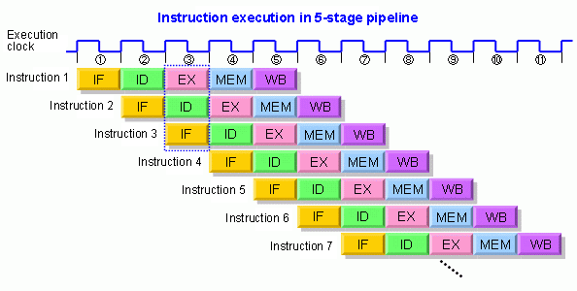
Instruction Level Parallelism

Slide 13
Task Parallelism
Entirely different tasks can be performed on either the same, or different sets of data concurrently.
Divide and conquer technique with problems.
Divide into smaller tasks and solve concurrently.
This is where your average software developer focuses. This is where you can make your app faster!

Slide 14
Ahmdal’s Law
Often used in parallel computing to predict the theoretical speedup when using multiple processors.
Example: A program needs 10 hours to run on a single core. One hour of that time is NOT parallelizable, the rest is. Amdahl’s law predicts the theoretical speedup being 1/.9=10 times faster with theoretical infinite processors.

Slide 15
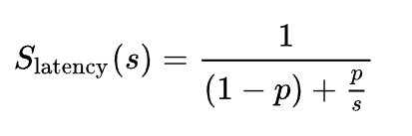
Amdahl’s Law
S_{latency} is the theoretical speedup of execution.
s is the speedup of the specific part of the task that benefits from parallelism.
p is the proportion of the total problem that s represents.

Slide 16
Threads
Each thread does it’s own thing.
They share memory (data) but don’t always use the same.
They must be written well to work well (no spaghetti here)
Managing your threads is like managing a battleship. You need to depend on each of your threads to do its job, and do it correctly while not getting in any other threads way.

Slide 17


Slide 18
Examples
A single threaded program that listens to user input would freeze an entire program.
With multiple threads, you don’t have to worry about it!
Lets simply print to infinity, but have an exit condition through user input.

Slide 19
Examples
What if we just want to send multiple tasks on there way, have them do their thing, and then return?
Lets spawn off “printing” tasks that prints a selected number between 1 and 50.
Why are certain numbers printing twice?
Why do some print after the menu reappears?

Slide 20
Why do some print twice?
Memory is shared by all threads, and threads have overhead
If thread 2 starts up late, it might not get the i value of 2. Instead it might get the i value of 3.
For this example, lets fix it by storing i in a temporary variable h.

Slide 21
Why after the menu?
The overhead for creating a thread, and doing the thread work is more than it takes for main to finish up what it is doing and loop back to the menu.
But we can fix that! We can ensure that we won’t continue the main thread until every other thread is finished.

Slide 22
Farming off work to threads
Main doesn’t want to bubble sort… Give that to another thread and have it inform you when it is finished.

Slide 23
Common issues with threading
Race conditions
Deadlock
Choosing the thread count

Slide 24
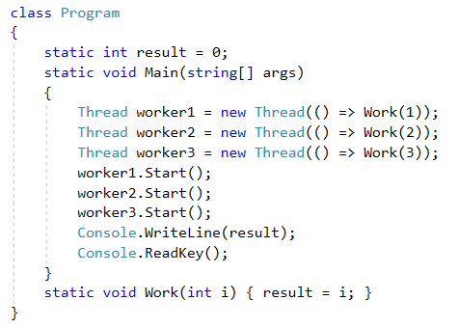
Race Conditions
Occurs when two threads try to change data at the same time. Whichever thread changes it LAST has the final word.

Slide 25
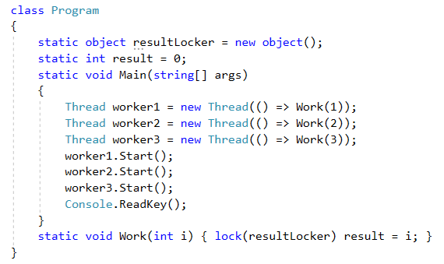
Race Condition Solution
Note, this is one of many potential solutions.
Create a lock object that can be used to ensure the correct results.

Slide 26
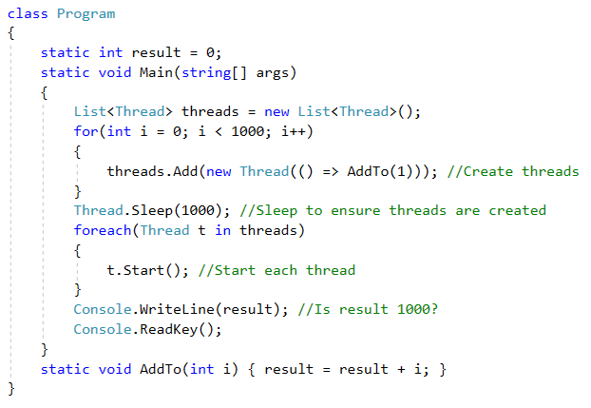
More complex race
The result should always be 1000, but you will find that isn’t always the case.
If two threads try to access, and then set the same variable at the same time they will conflict.

Slide 27
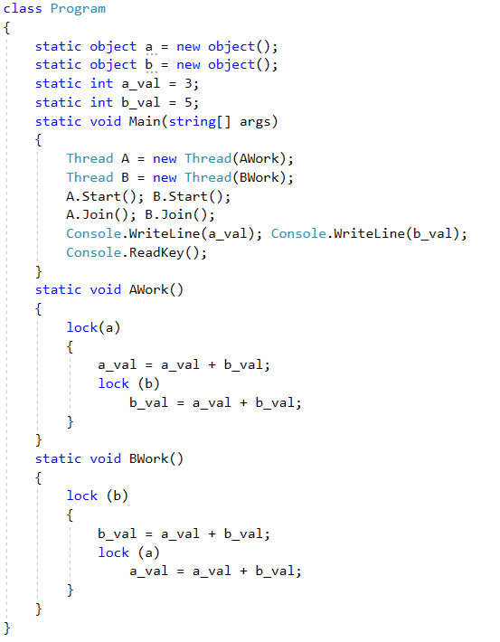
Deadlock
Thread A has variable a locked, but is waiting for variable b
Thread B has variable b locked, but is waiting for variable a
These two threads will be frozen forever.

Slide 28
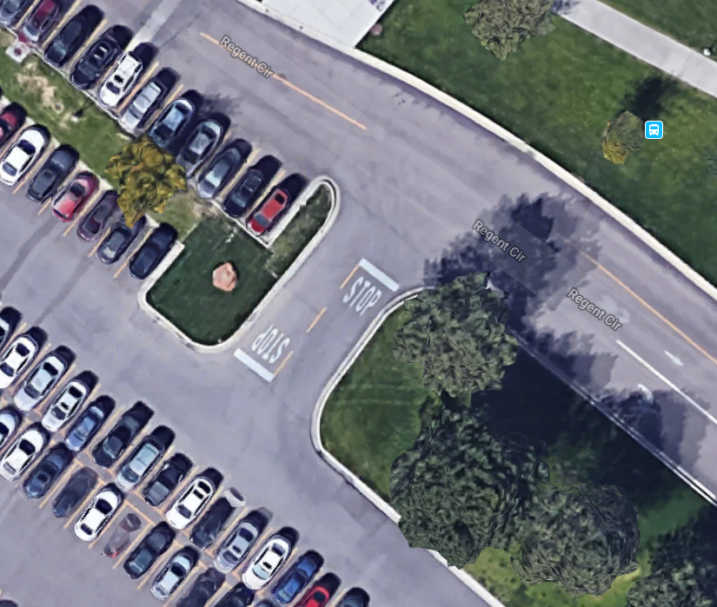

Slide 29
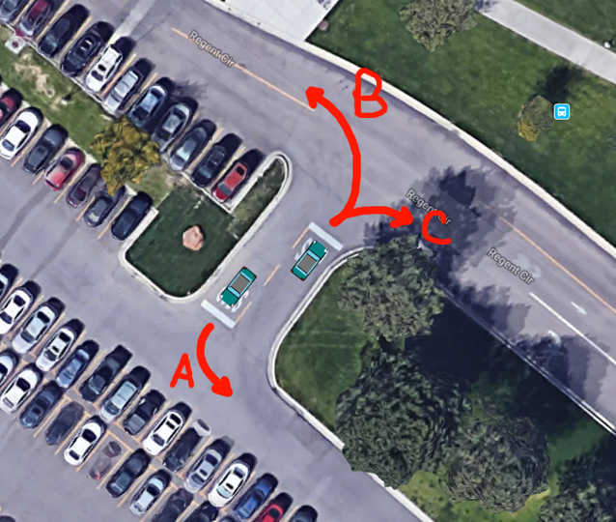

Slide 30
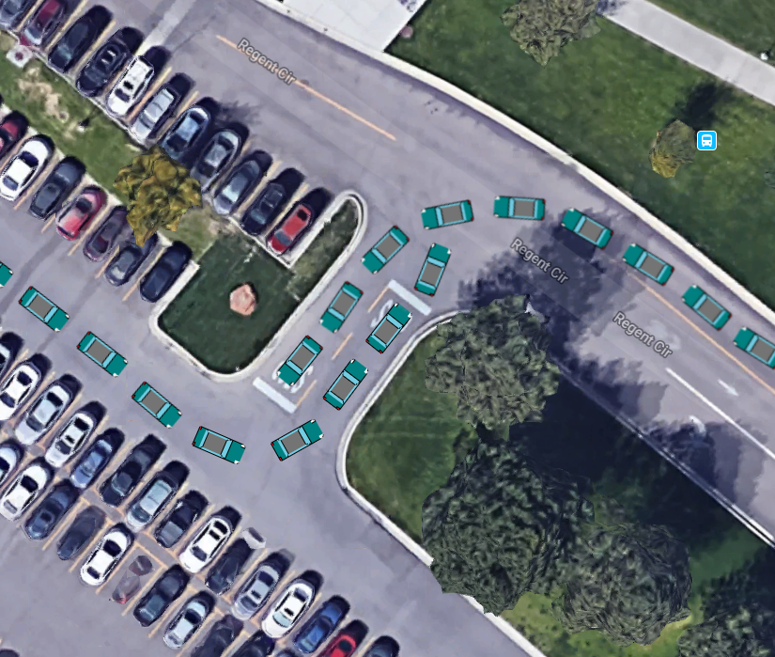

Slide 31
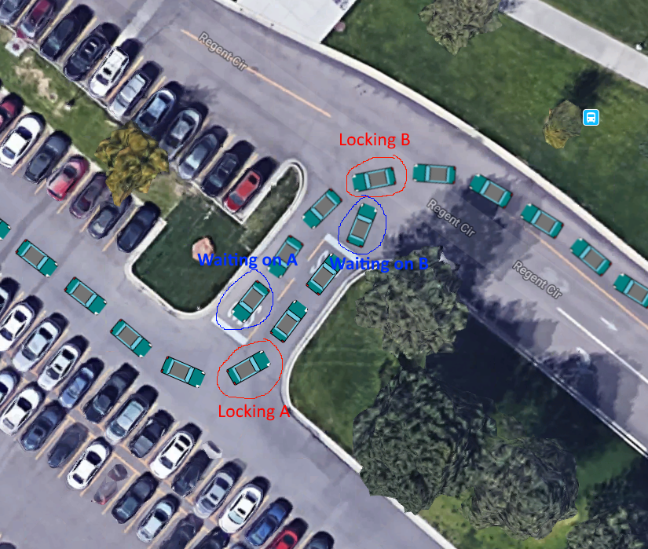

Slide 32
Choosing the thread count
Too much of a good thing is a better thing, right?
Wrong! Creating a thread has some pretty massive overhead and should only be done when the performance gained outweighs the performance lost.
Similarly, a lot of computation on just a few threads would be better optimized if you used more threads!

Slide 33
Choosing the thread count
It all depends on the machine and the problem you are working on…
Some professionals say never use more than 1 thread per core, others say use 50 per core, etc…
The smartest thing you can do is test. Try breaking your problem into 10 sub problems, 50 sub problems, 100 sub problems. Which one yielded the best results?

Slide 34
.NET Tasks
Threads are awesome, but they are expensive and REALLY hard to do correctly.
Lucky for us, .NET built a structure for us to use that optimizes everything for us!
Tasks and the Task Factory!
Lets see if we can optimize thread counts for simple math
Notes:
Tasks, SortingAlgorithmTest, CalculatePiOnSingleThread, CollisionDetection

Slide 35
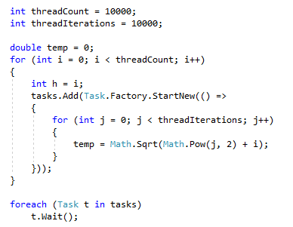
Task Factory
Task factory takes care of some of the overhead for us by optimizing the way threads are created and pooled.
Similarly to threads, we can wait for each task to ensure they all finished.

Slide 36

Sort Comparisons
Bubble sort is slow…
Merge sort is fast!
Parallelized merge is even faster!
Demonstration
Notes:
Example of how creating big array locks program. I could have put that on a thread and been able to click boxes.

Slide 37
Issue solvable with threading
When I generate a huge array, my program freezes. This is due to the program consisting of only a single thread at that point.
Lets fix that!

Slide 38
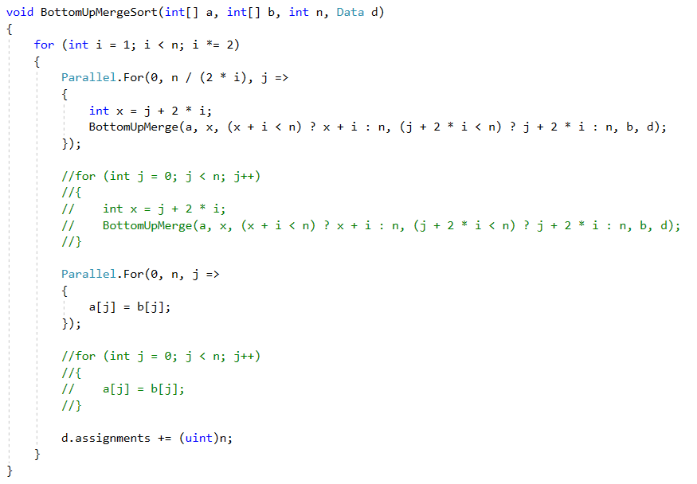
Issue with threading merge sort
What is the issue here?
Why is it an issue?
Why is this something easily overlooked?

Slide 39
Practice
Create a program that opens a new thread (task) and uses it to calculate pi. Whenever the user presses a key, prints the current calculated value. Allow for repeated presses to print the more accurate value as more time = more convergence.
An easy way to calculate pi is the Gregory-Leibniz Series
Pi/4 = 1 – 1/3 + 1/5 - 1/7 + 1/9….
Alternating subtraction and addition
Changing denominator to next highest odd number.

Slide 40
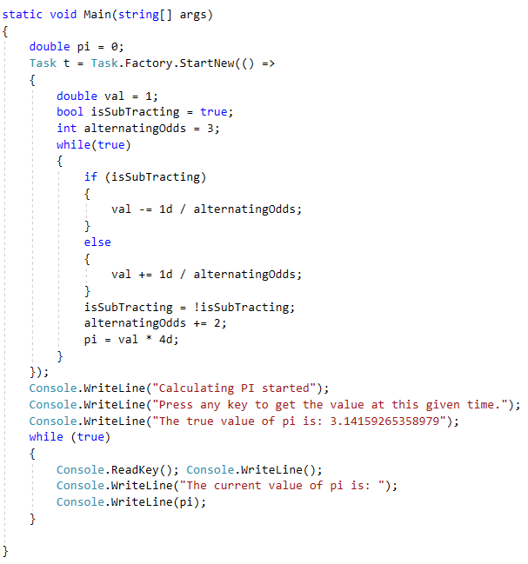
My solution
I intentionally left a runtime error here.
What is it?
Hint: it will result in our answer diverging far from where it should be after a period of running.
Hint: Has nothing to do with threading!

Slide 41
Assignment, due after break
Handle collision detection with an increasing number of objects.
The only code you need to change is CollisionDetectionParallel() and line 62/63.
Mac users, see note on Canvas.

Slide 42
